Slide 1
Personality Detection System
Using K-Means Clustering Algorithm

Slide 2
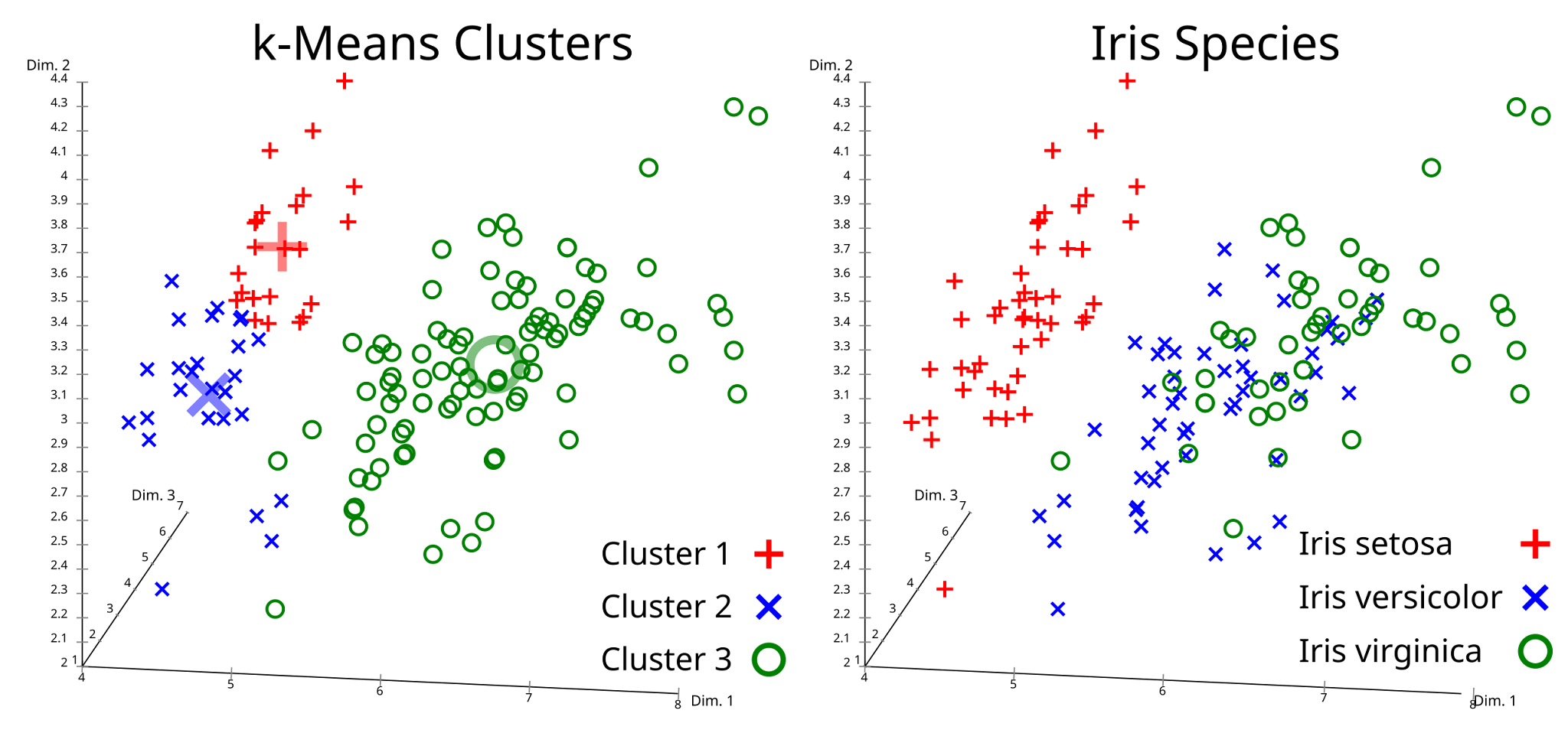
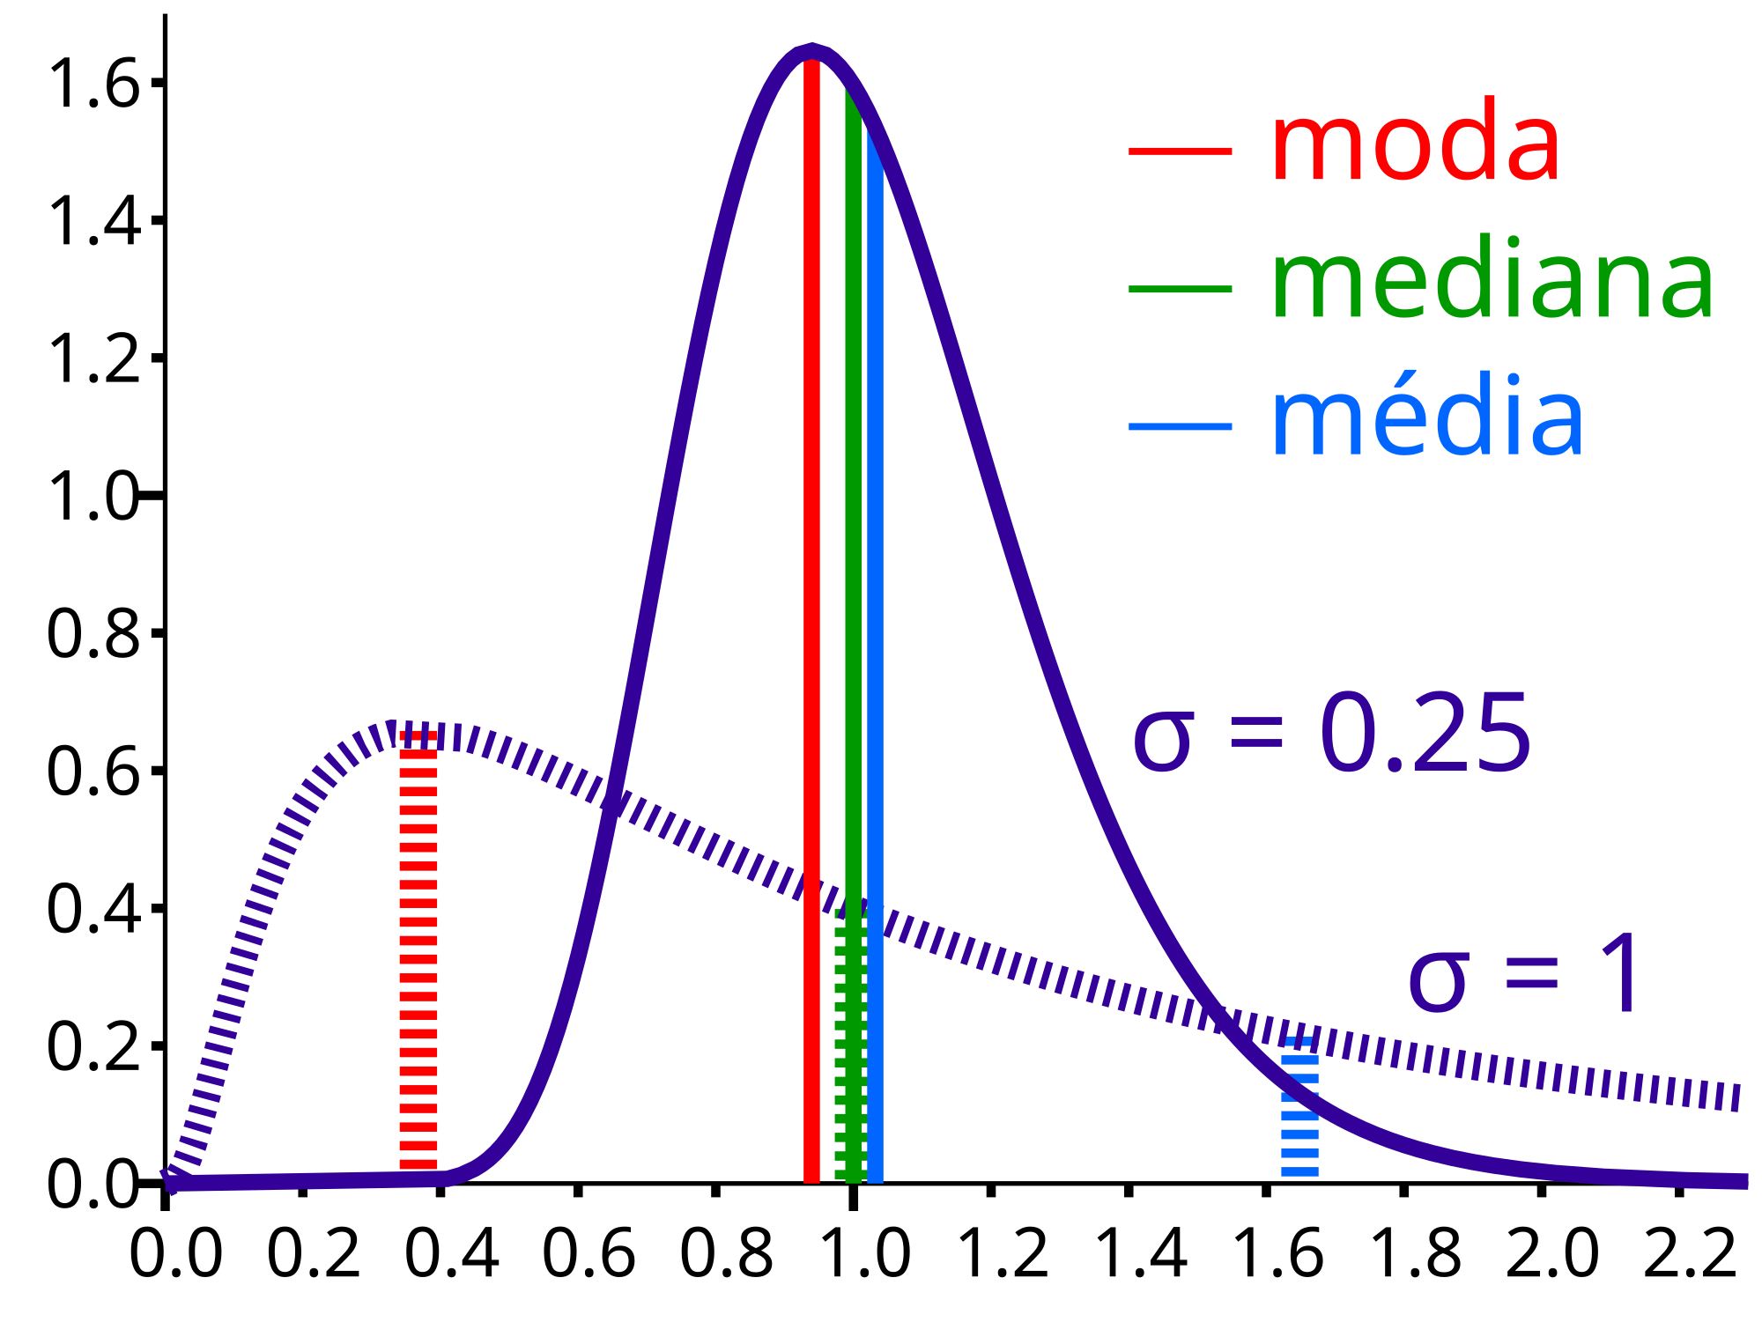
K-Means Clustering
K-Means Clustering is an unsupervised machine learning algorithm used to partition a dataset into K distinct, non-overlapping subsets (clusters). The goal is to divide the data points into clusters such that each data point belongs to the cluster with the nearest mean, serving as a prototype of the cluster.

Slide 3
Implementation of K-Means in Personality Detection System
In this project, K-Means clustering is used to group individuals based on their personality traits. The steps involved are:
Data Collection:
Collect data that includes personality traits, typically using the Big Five personality traits model.
Data Preprocessing:
Handle missing values by filling them with the mean of the column.
Normalize the data to ensure all features contribute equally to the distance calculations.
Feature Selection:
Select relevant features, such as the Big Five personality traits: Openness, Conscientiousness, Extraversion, Agreeableness, and Neuroticism.

Slide 4
4. Clustering with K-Means:
Determine the optimal number of clusters using the Elbow method, which involves plotting the Within-Cluster Sum of Squares (WCSS) for different values of K and looking for the "elbow point."
Apply the K-Means algorithm with the chosen number of clusters to partition the data.
5. Evaluation:
Add the cluster labels to the original data.
Analyze the cluster centers to understand the characteristics of each cluster.
6. Interpretation:
Interpret the clusters to identify different personality types based on the cluster centers.
https://colab.research.google.com/github/ShraavaniKR/html-portfolio/blob/main/personalityML.ipynb

